Slide 1
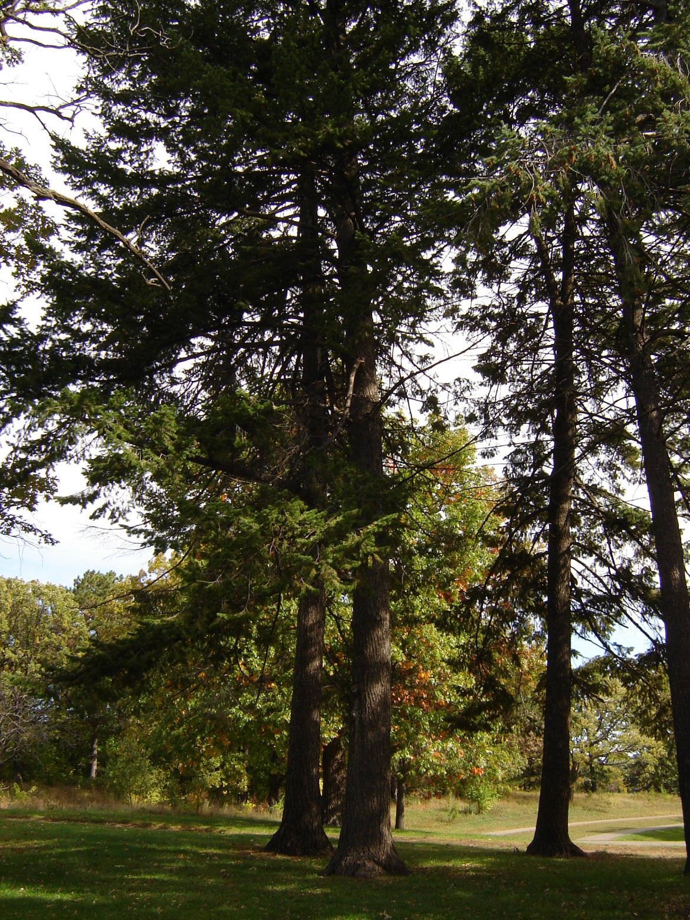
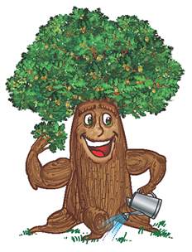
City of Saint Paul Department of Parks & Recreation Operations Division Natural Resources Section FORESTRY

Slide 2
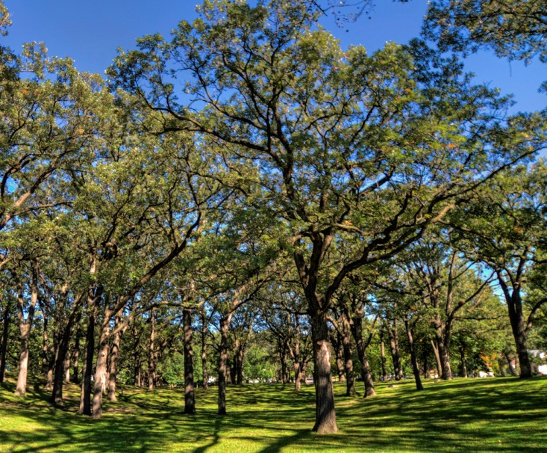
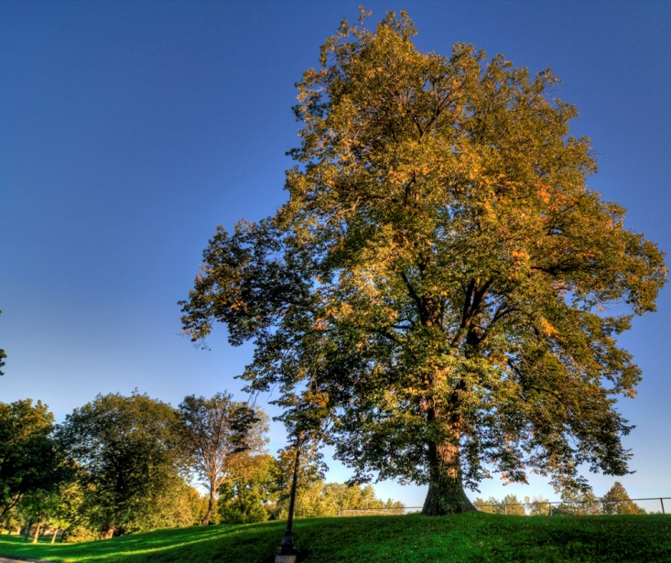
Urban Trees: Green Infrastructure
Trees are vital ASSETS that provide numerous environmental, economic, and social benefits
32.5% canopy coverage (U of M, 2010 Canopy Assessment)
Publicly-Owned Trees: Private Trees # ???
130,000 Boulevard trees (26K were ash trees)
500,000 parks/open space (est)

Slide 3
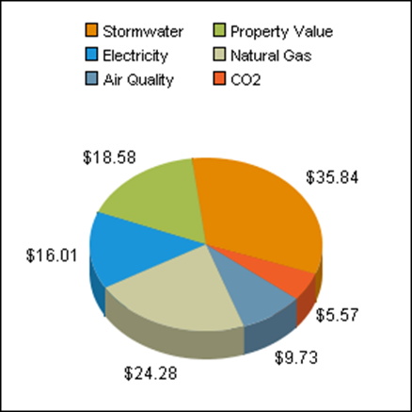
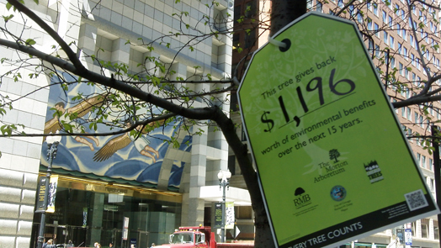
Value of Trees
Benefits can be calculated in dollars through energy savings, storm water filtration, carbon sequestration, property values, even health costs.
Bigger trees provide bigger benefits!
Above: Annual benefits of avg. 14” tree

Slide 4
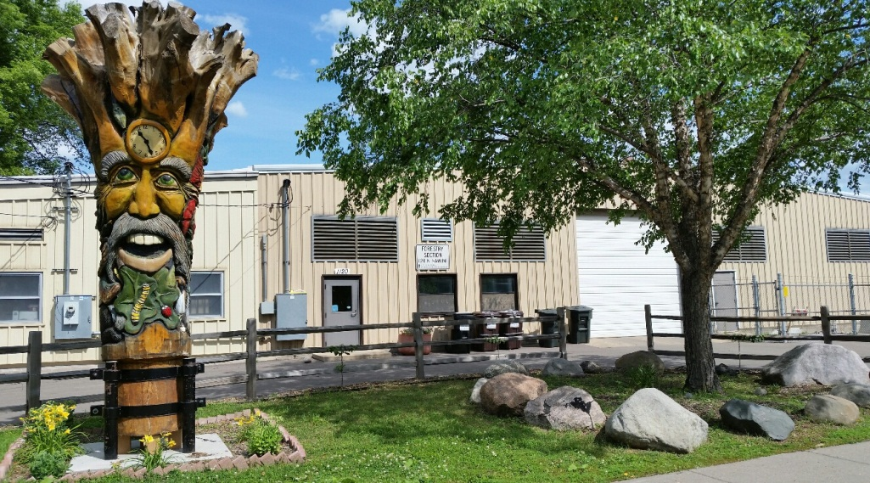
Saint Paul Forestry 1120 Hamline Ave N. St. Paul, MN 55108 www.stpaul.gov/forestry 651-632-5129
100 years old
Publicly-owned trees: Plant and maintain all--street boulevards, parks/open spaces (exception: Xcel power lines)
Private property: Enforce ordinances for disease, infested and dangerous trees (Inspect, orders, abate, assess)
40 FTEs for 52 square miles (Mpls 80 FTEs for 54 sq. miles)
Trained, experienced, increasingly educated, dedicated
Equipment: 9 aerial buckets, 5 clams, 5 dump trucks, …
One of the few cities in Minnesota that does all Forestry work

Slide 5
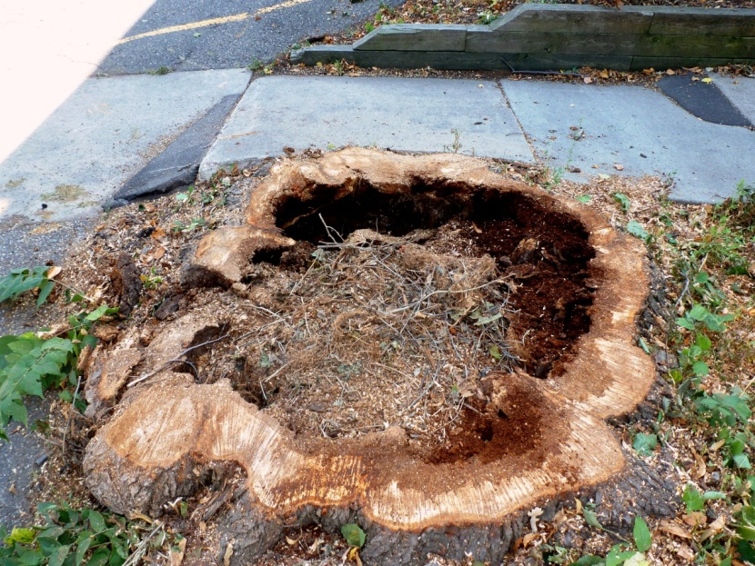
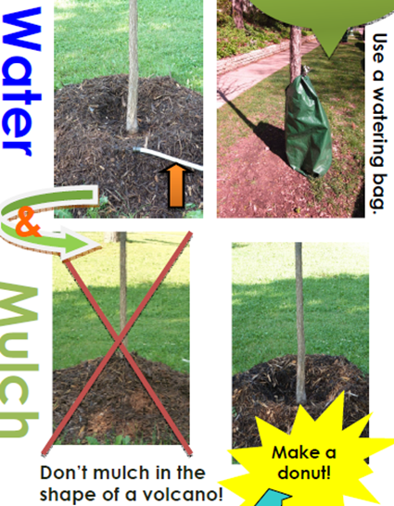
Core Functions
Inspection, inventory, …
Pruning: for safety and tree health
Removals—trees & stumps: for safety and tree disease prevention
Planting: new and reforestation
Storm clean ups
Construction mitigation
General maintenance: e.g., watering
Education and outreach: e.g., Arbor Month programs, Citizen Pruners, volunteer planting events
Permits

Slide 6
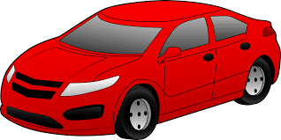
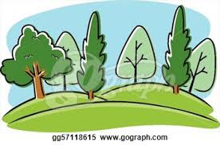
Budget (2014 figures)
Right-of-Way Assessment (beginning in 2003)
for regular tree work ($2.6M)
for EAB beginning in 2010 ($1.2M)
General Fund for parks, private property and other non-ROW work ($600K)
Annual CIB City-Wide Tree Planting = $350K

Slide 7
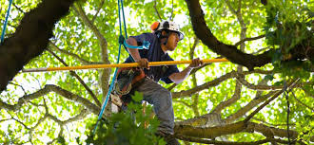
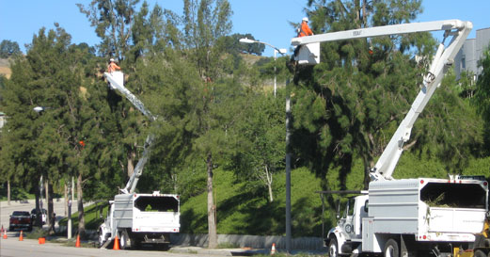
Pruning!
Preventative maintenance provides best value
Core function that suffers due to other demands
Lack of pruning leads to other issues, e.g., increased storm damage, increased complaints and response calls (huge back log in summer season)
Citizen Pruners can help some with ground level work

Slide 8
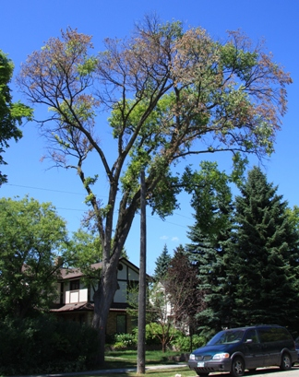
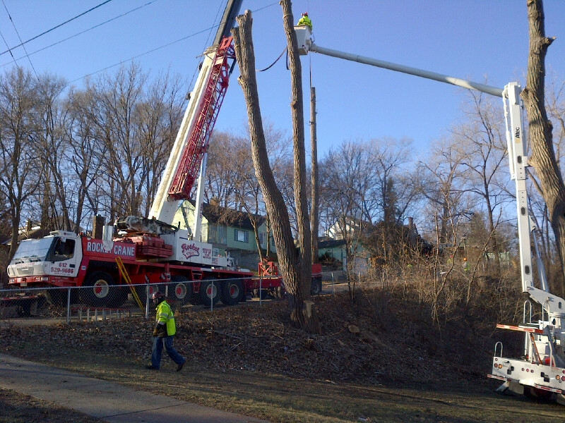
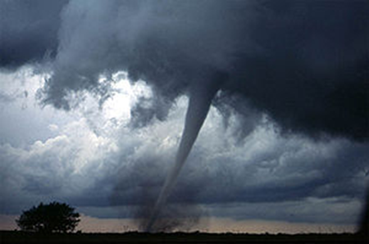
Removals
Most visible, sad, controversial function
~2,000 regular removals annually (senescence, DED, SGR, storms, accidents/vandalism, construction)
1,100 for EAB management
Total = ~3,000 trees annually

Slide 9
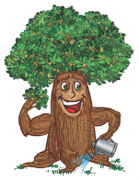
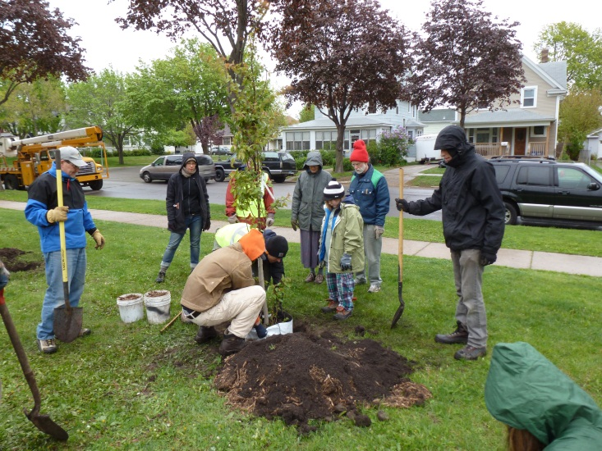
Tree Planting
Most tree planting is actually replanting for lost trees
CIB is the only regular annual fund for tree planting, ~$300,000 (pays for ~1,000 2” B&B trees)
Other opportunities sought:
Public Works or Parks Design construction projects
Friends of the Parks and Trails of St. Paul and Ramsey County
University of Minnesota: Dept. of Forest Resources (research trees)
Grants, e.g., State DNR or MDA
Local community groups, e.g. Frogtown Tree Frogs
Volunteers and individual donations
Above: Arbor Month volunteer planting at Horton Park

Slide 10
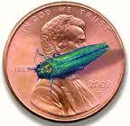
Emerald Ash Borer (EAB)
Management Program initiated in 2010:
Monitoring: Annual survey of infested zones to identify removal candidates—public & private
Sanitation: Prompt removal of all identified infested ash trees
2014: Public 314 Private 280
Structured Removal: reduce # of declining non-infested ash trees
~1,100 per year Total since 2009 = 5,381
Insecticide Treatment: used in infested areas to reduce EAB population growth. (Currently 2,100 trees enrolled in treatment program)
Reforestation: Replace lost trees 1:1 while increasing diversity throughout the city and down to the block
Inventory: Street trees are being inventoried city-wide for management purposes
Collaborative Efforts With Other Agencies:
Bio-control releases, Branch sampling, and Monitoring

Slide 11
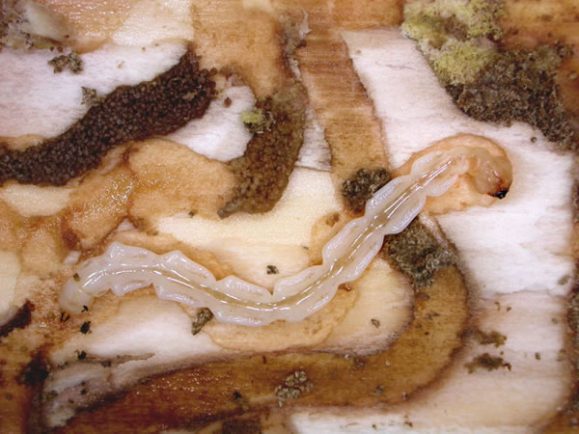
EAB and District 5
District 5 has had no case of “confirmed” EAB yet
However, over 60% of the city is already suspect of EAB based on 1 mile buffer guidelines— includes lower District 5–and it’s progressing
District 5 now has the largest number of boulevard ash trees at over 2,100 to be managed
The EAB “mortality curve” will present a daunting task and even health impacts due to expected large loss of ash trees once EAB infestation occurs
The City’s main strategy is to remove the worst condition ash trees and replant employing diversity
174 ash trees have been removed since Jan 1 and plans need to ramp up in future years
Private property ash trees will create huge financial problems for both individuals and the community
Increased tree planting beginning now is one good strategy to combat issue

Slide 12
Miscellaneous Questions
What’s up with Phalen Boulevard trees?
Poor soils, i.e., non-fertile, compacted, after earth moving
Selection of trees not conducive to soils and conditions, e.g., salt
Lack of maintenance funds/effort, including watering
Damage to trees—need protection and education
What about more flowering ornamental trees?
Vast majority of limited funds are needed to replace lost canopy as top priority. Ornamentals are increasingly used in compromised sites, i.e., under power lines. They are good complimentary trees for aesthetics and wild life. Good community project!
How can pruning and watering be improved?
Advocate for more resources
Become Citizen Pruner (very limited in scope, however, due to liability)
Start neighborhood mulch & watering campaign led by block captains

Slide 13
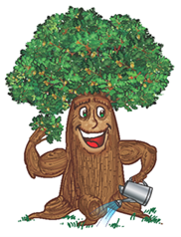
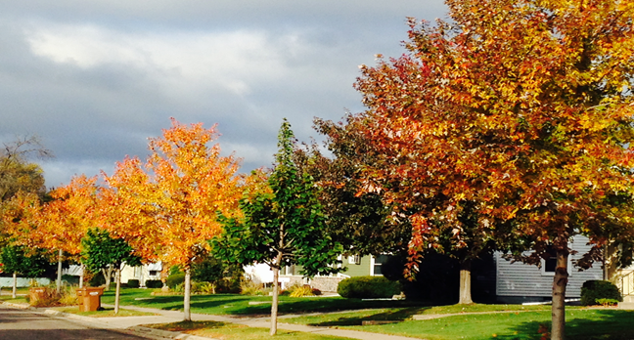
Please visit or web site for more information: www.stpaul.gov/forestry
Thank you,
Cy Kosel
Natural Resources Manager
Burly Oak

